Slide 1

COURSE SLIDES
Certified Lean Six Sigma Black Belt (CLSSBB) Training
WSQ Course Code: TGS-2024051900 Conducted by Tertiary Infotech Academy Pte Ltd
Version 1
Copyright 2026 Tertiary Infotech Academy Pte Ltd. All rights reserved.
Certified Lean Six Sigma Black Belt (CLSSBB) Training | TGS-2024051900
Tertiary Infotech Academy Pte Ltd
1

Slide 2
ADMIN
Welcome and Course Administration
• Training hours: 9:00 AM to 6:00 PM each day.
• Please sign in and complete SSG digital attendance as instructed.
• Keep your lab journal open throughout the course.
Certified Lean Six Sigma Black Belt (CLSSBB) Training | TGS-2024051900
Tertiary Infotech Academy Pte Ltd
2

Slide 3
YOUR TRAINER - GENERAL
About the Trainer
NAME
?
TITLE / DESIGNATION
QUALIFICATIONS
AREAS OF EXPERTISE
Your Trainer
General Trainer template - to be completed by the trainer
TRAINING & INDUSTRY EXPERIENCE
CONTACT
Certified Lean Six Sigma Black Belt (CLSSBB) Training | TGS-2024051900
Tertiary Infotech Academy Pte Ltd
3

Slide 4
YOUR TRAINER
About the Trainer
ROLE
AA
Principal Trainer, Tertiary Infotech Academy Pte. Ltd.
QUALIFICATIONS
PhD - specialises in AI, automation and software engineering.
Dr. Alfred Ang
DELIVERS
WSQ courses on Lean Six Sigma, analytics, AI automation and app development.
Principal Trainer Tertiary Infotech Academy Pte. Ltd.
FOUNDER
Founder and lead instructor at Tertiary Infotech / Tertiary Courses.
Certified Lean Six Sigma Black Belt (CLSSBB) Training | TGS-2024051900
Tertiary Infotech Academy Pte Ltd
4

Slide 5
ADMIN
Digital Attendance is Mandatory
• AM, PM, and assessment attendance must be completed where required.
• Minimum attendance requirements apply for funding and assessment eligibility.
• Use the displayed QR code or portal instructions from the trainer.
Certified Lean Six Sigma Black Belt (CLSSBB) Training | TGS-2024051900
Tertiary Infotech Academy Pte Ltd
5

Slide 6
HOUSEKEEPING
Ground Rules
1
Set your mobile phone to silent mode.
2
Participate actively - no question is too small.
3
Mutual respect: agree to disagree.
4
One conversation at a time.
5
Be punctual; return from breaks on time.
6
75% attendance is required.
Certified Lean Six Sigma Black Belt (CLSSBB) Training | TGS-2024051900
Tertiary Infotech Academy Pte Ltd
6

Slide 7
ADMIN
Courseware and LMS
• Slides, learner guide, lab instructions, and assessment access are provided through the LMS.
• Save a local copy of your project artifacts after each lab.
• Use the lab files as the authority for hands-on tasks.
Certified Lean Six Sigma Black Belt (CLSSBB) Training | TGS-2024051900
Tertiary Infotech Academy Pte Ltd
7

Slide 8
ASSESSMENT
Assessment Overview
• Final assessment and project review take place on Day 2.
• Assessment checks Black Belt concepts and application to DMAIC project artifacts.
• Open courseware where permitted by the trainer's assessment instructions.
Certified Lean Six Sigma Black Belt (CLSSBB) Training | TGS-2024051900
Tertiary Infotech Academy Pte Ltd
8

Slide 9
ASSESSMENT
Assessment Flow Reminder
1
2
3
4
5
TRAQOM digital attendance
>
Assessment digital attendance
>
Sit WA then Case Study
>
Submit answers on the LMS
>
Sign Assessment Summary Record
The TRAQOM QR code and LMS submission are both handled through the LMS/TMS portal.
Certified Lean Six Sigma Black Belt (CLSSBB) Training | TGS-2024051900
Tertiary Infotech Academy Pte Ltd
9

Slide 10
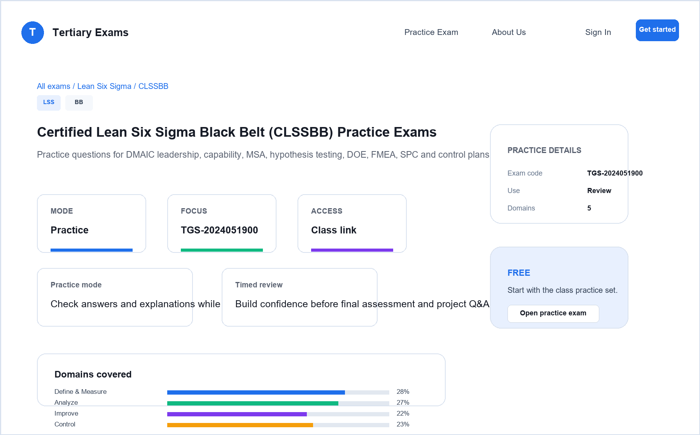
PRACTICE EXAM
Take the Online CLSSBB Practice Exams
• Reinforce all five DMAIC phases with realistic, exam-style questions before assessment day.
• Use practice sets to test capability, MSA, hypothesis testing, DOE, FMEA, SPC and control plans.
• Review mode helps you check the correct answer and revisit the concept after each question.
• Complete the practice questions from Google Classroom, then bring difficult items to the review session.
Access and practise at:
Google Classroom > Practice Exams
Certified Lean Six Sigma Black Belt (CLSSBB) Training | TGS-2024051900
Tertiary Infotech Academy Pte Ltd
10

Slide 11
COURSE OUTCOMES
Learning Outcomes
• Lead a DMAIC improvement project at Black Belt level.
• Use statistical and Lean tools to validate decisions.
• Build deliverables that transfer ownership to the process owner.
Certified Lean Six Sigma Black Belt (CLSSBB) Training | TGS-2024051900
Tertiary Infotech Academy Pte Ltd
11

Slide 12
COURSE MAP
Course Flow
• Day 1: Define and Measure phases.
• Day 2: Analyze, Improve, Control, assessment and closure.
• All labs use one project scenario end to end.
Certified Lean Six Sigma Black Belt (CLSSBB) Training | TGS-2024051900
Tertiary Infotech Academy Pte Ltd
12

Slide 13
TOOLS
Tools Used
• Excel, LibreOffice Calc, or Google Sheets for analysis.
• diagrams.net or equivalent for maps and fishbone diagrams.
• Project templates for charter, SIPOC, FMEA, control plan, and storyboard.
Certified Lean Six Sigma Black Belt (CLSSBB) Training | TGS-2024051900
Tertiary Infotech Academy Pte Ltd
13

Slide 14
LABS
Lab Rules
• Use one project scenario across all labs.
• Keep formulas visible where possible.
• Do not claim root cause without evidence.
• Save every chart and artifact for the final project storyboard.
Certified Lean Six Sigma Black Belt (CLSSBB) Training | TGS-2024051900
Tertiary Infotech Academy Pte Ltd
14

Slide 15
ADMIN
Version Control and Copyright
• Version 1.0 issued 9 July 2026.
• Copyright 2026 Tertiary Infotech Academy Pte Ltd. All rights reserved.
• Do not redistribute without permission.
Certified Lean Six Sigma Black Belt (CLSSBB) Training | TGS-2024051900
Tertiary Infotech Academy Pte Ltd
15

Slide 16
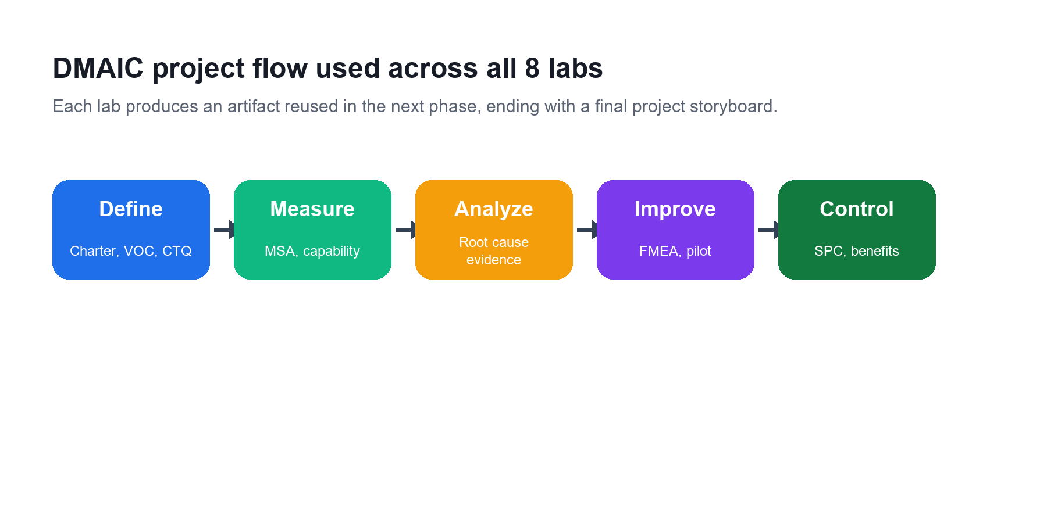
COURSE MAP
DMAIC is the spine of the course
• Each lab produces an artifact reused later.
• Define and Measure establish trustworthy scope and baseline.
• Analyze, Improve, and Control convert evidence into sustained results.
Certified Lean Six Sigma Black Belt (CLSSBB) Training | TGS-2024051900
Tertiary Infotech Academy Pte Ltd
16

Slide 17
PROJECT STORY
Black Belt project artifacts accumulate across the labs
• Charter and CTQs define what matters.
• SIPOC, maps, and data plans define how to measure.
• Tests, FMEA, and control plans define how to decide and sustain.
Certified Lean Six Sigma Black Belt (CLSSBB) Training | TGS-2024051900
Tertiary Infotech Academy Pte Ltd
17

Slide 18
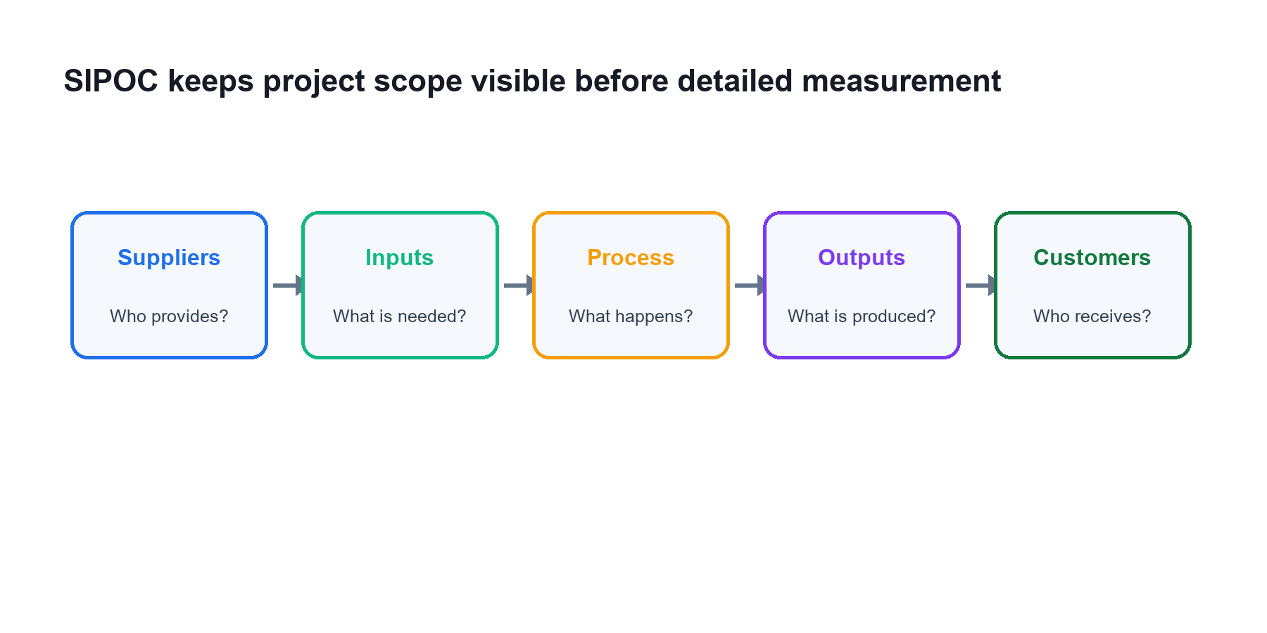
DEFINE
SIPOC links customer requirements to the process boundary
• Start broad enough to see suppliers and customers.
• Use the map to choose useful data collection points.
• Update scope notes when the map exposes ambiguity.
Certified Lean Six Sigma Black Belt (CLSSBB) Training | TGS-2024051900
Tertiary Infotech Academy Pte Ltd
18

Slide 19
MEASURE
Measurement quality comes before statistical confidence
• Operational definitions prevent inconsistent data.
• MSA risk notes document whether the metric can be trusted.
• Capability claims require stable and relevant data.
Certified Lean Six Sigma Black Belt (CLSSBB) Training | TGS-2024051900
Tertiary Infotech Academy Pte Ltd
19

Slide 20
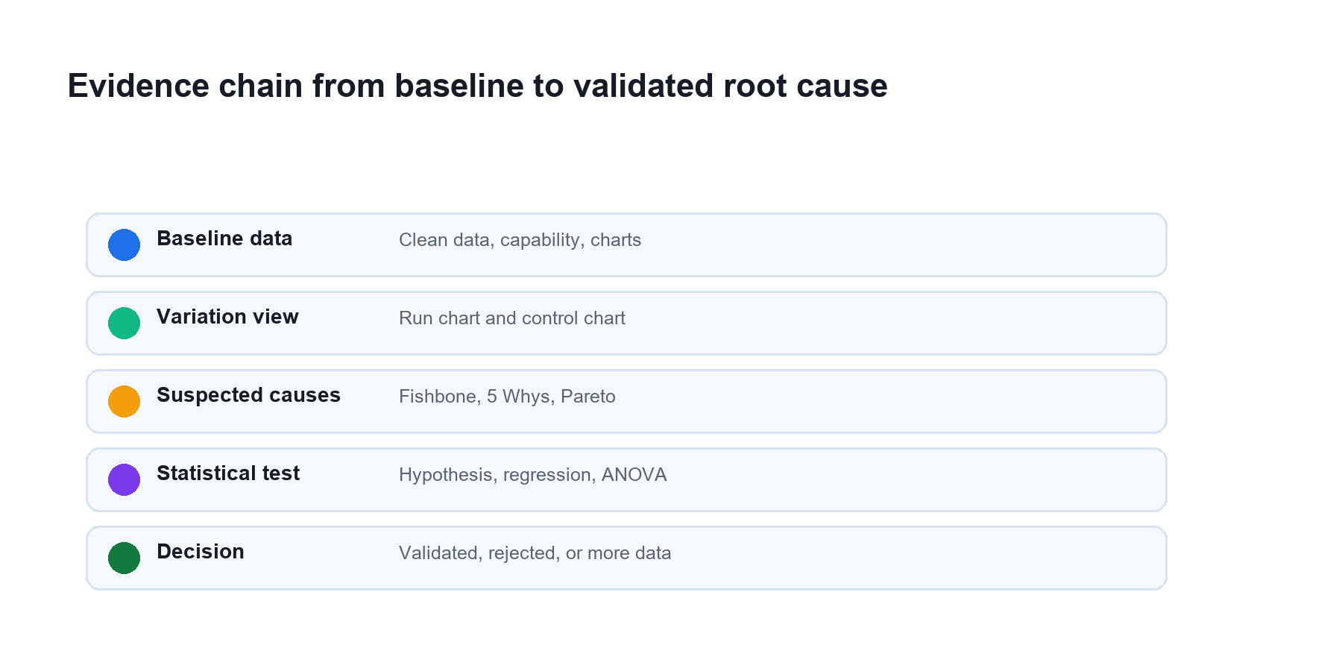
ANALYZE
Root causes need an evidence chain
• Use fishbone and 5 Whys to generate causes.
• Use Pareto, tests, regression, or ANOVA to validate causes.
• Separate statistical significance from practical significance.
Certified Lean Six Sigma Black Belt (CLSSBB) Training | TGS-2024051900
Tertiary Infotech Academy Pte Ltd
20

Slide 21
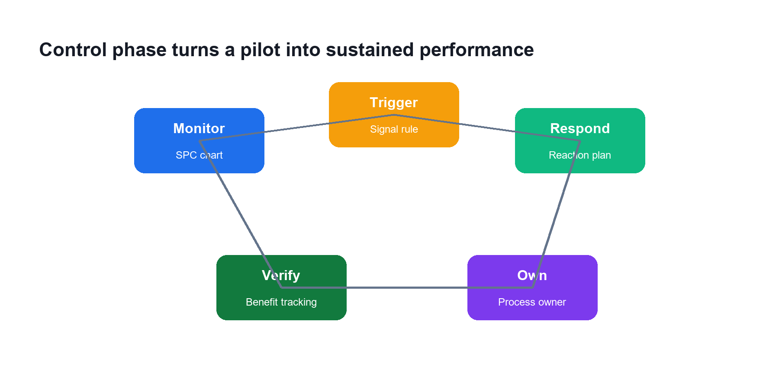
CONTROL
Control turns improvement into ownership
• SPC detects performance drift.
• Response plans tell owners what to do.
• Benefits tracking keeps gains visible after handover.
Certified Lean Six Sigma Black Belt (CLSSBB) Training | TGS-2024051900
Tertiary Infotech Academy Pte Ltd
21

Slide 22
LAB OVERVIEW
Lab 01: Project Charter, VOC, and CTQ Tree
• Select a Black Belt project scenario.
• Build a project charter.
• Capture voice of customer.
• Translate VOC into measurable CTQs.
Certified Lean Six Sigma Black Belt (CLSSBB) Training | TGS-2024051900
Tertiary Infotech Academy Pte Ltd
22

Slide 23
STEP-BY-STEP
Lab 01 scenario and work sequence
• You have been assigned to lead a process improvement project. Before collecting data, you must define the business problem, scope, customers, and measurable success criteria.
• Select a process problem from your workplace or use a trainer-provided scenario.
• Write a one-paragraph business case.
• Write the problem statement using current performance facts.
• Avoid including assumed causes in the problem statement.
• Write a SMART goal statement.
Certified Lean Six Sigma Black Belt (CLSSBB) Training | TGS-2024051900
Tertiary Infotech Academy Pte Ltd
23

Slide 24
VALIDATION
Lab 01 completion check
• The problem statement includes measurable current performance.
• The goal statement has target and timeline.
• Each CTQ can be measured.
• Scope boundaries are clear enough to prevent project drift.
• Deliverables: Project charter.; RACI table.; VOC table.; CTQ tree.
Certified Lean Six Sigma Black Belt (CLSSBB) Training | TGS-2024051900
Tertiary Infotech Academy Pte Ltd
24

Slide 25
REFLECT
Lab 01 review questions
• Why should a problem statement avoid assumed causes?
• What makes a CTQ measurable?
• How does project scope protect the team?
• What is the Black Belt's role in stakeholder alignment?
Certified Lean Six Sigma Black Belt (CLSSBB) Training | TGS-2024051900
Tertiary Infotech Academy Pte Ltd
25

Slide 26
LAB OVERVIEW
Lab 02: SIPOC, Process Map, and Waste Analysis
• Build a SIPOC.
• Map the current-state process.
• Identify handoffs, queues, rework, and waste.
• Refine the project scope.
Certified Lean Six Sigma Black Belt (CLSSBB) Training | TGS-2024051900
Tertiary Infotech Academy Pte Ltd
26

Slide 27
STEP-BY-STEP
Lab 02 scenario and work sequence
• The project charter defines the problem, but the team needs a shared view of the process before measuring performance. You will map the current process and identify where waste may exist.
• Write the process start event and end event.
• List the main customers and outputs.
• List the major process steps between start and end.
• List key inputs and suppliers.
• Build a SIPOC table.
Certified Lean Six Sigma Black Belt (CLSSBB) Training | TGS-2024051900
Tertiary Infotech Academy Pte Ltd
27

Slide 28
VALIDATION
Lab 02 completion check
• The SIPOC matches the project scope.
• The process map is understandable to someone outside the team.
• Waste examples are linked to actual steps.
• Data collection points are identified.
• Deliverables: SIPOC.; Current-state process map.; Waste analysis table.; Updated scope notes.
Certified Lean Six Sigma Black Belt (CLSSBB) Training | TGS-2024051900
Tertiary Infotech Academy Pte Ltd
28

Slide 29
REFLECT
Lab 02 review questions
• Why is SIPOC useful before detailed process mapping?
• What is the difference between value-added and business-value-added work?
• How can process maps reveal hidden rework?
• Why should data collection points be chosen after mapping?
Certified Lean Six Sigma Black Belt (CLSSBB) Training | TGS-2024051900
Tertiary Infotech Academy Pte Ltd
29

Slide 30
LAB OVERVIEW
Lab 03: Data Collection, MSA, and Process Capability
• Create a data collection plan.
• Define units, defects, and opportunities.
• Assess measurement system risks.
• Calculate baseline process performance.
Certified Lean Six Sigma Black Belt (CLSSBB) Training | TGS-2024051900
Tertiary Infotech Academy Pte Ltd
30

Slide 31
STEP-BY-STEP
Lab 03 scenario and work sequence
• The team needs trustworthy baseline data. You must define the metric carefully, check whether measurement is reliable, and calculate current process capability.
• Select the primary Y metric from the CTQ tree.
• Write an operational definition for the metric.
• Define unit, defect, opportunity, target, and specification limits if available.
• Choose sampling period, sample size, data source, and data owner.
• Build a data collection plan.
Certified Lean Six Sigma Black Belt (CLSSBB) Training | TGS-2024051900
Tertiary Infotech Academy Pte Ltd
31

Slide 32
VALIDATION
Lab 03 completion check
• The metric has an operational definition.
• Data collection responsibility is assigned.
• Measurement risks are documented.
• Capability calculations match the data type.
• Deliverables: Data collection plan.; Operational definition.; MSA risk notes.; Capability worksheet.
Certified Lean Six Sigma Black Belt (CLSSBB) Training | TGS-2024051900
Tertiary Infotech Academy Pte Ltd
32

Slide 33
REFLECT
Lab 03 review questions
• Why can poor measurement systems invalidate a project?
• When would you use DPMO instead of Cp/Cpk?
• What is the difference between short-term and long-term capability?
• Why must specification limits come from customer or business requirements?
Certified Lean Six Sigma Black Belt (CLSSBB) Training | TGS-2024051900
Tertiary Infotech Academy Pte Ltd
33

Slide 34
LAB OVERVIEW
Lab 04: Baseline Analysis and Control Charts
• Summarize baseline data.
• Create visual analysis charts.
• Select appropriate control charts.
• Interpret stability and variation.
Certified Lean Six Sigma Black Belt (CLSSBB) Training | TGS-2024051900
Tertiary Infotech Academy Pte Ltd
34

Slide 35
STEP-BY-STEP
Lab 04 scenario and work sequence
• Before searching for root causes, the team must understand baseline variation. A process that is unstable should not be summarized only by averages.
• Import baseline data into a spreadsheet.
• Check for missing values, duplicates, and obvious data entry errors.
• Calculate count, mean, median, standard deviation, minimum, maximum, and range.
• Create a histogram.
• Create a time series or run chart.
Certified Lean Six Sigma Black Belt (CLSSBB) Training | TGS-2024051900
Tertiary Infotech Academy Pte Ltd
35

Slide 36
VALIDATION
Lab 04 completion check
• Descriptive statistics are calculated correctly.
• The chart type matches the data.
• Special cause signals are clearly marked.
• The baseline interpretation separates average performance from variation.
• Deliverables: Descriptive statistics table.; Histogram.; Run chart or time series plot.; Control chart.; Baseline interpretation.
Certified Lean Six Sigma Black Belt (CLSSBB) Training | TGS-2024051900
Tertiary Infotech Academy Pte Ltd
36

Slide 37
REFLECT
Lab 04 review questions
• Why should stability be checked before capability claims?
• What is common cause variation?
• What is special cause variation?
• How does chart selection depend on data type?
Certified Lean Six Sigma Black Belt (CLSSBB) Training | TGS-2024051900
Tertiary Infotech Academy Pte Ltd
37

Slide 38
LAB OVERVIEW
Lab 05: Root Cause Analysis and Hypothesis Testing
• Generate possible root causes.
• Prioritize causes using data.
• Select appropriate hypothesis tests.
• Interpret statistical and practical significance.
Certified Lean Six Sigma Black Belt (CLSSBB) Training | TGS-2024051900
Tertiary Infotech Academy Pte Ltd
38

Slide 39
STEP-BY-STEP
Lab 05 scenario and work sequence
• The team has many opinions about why the process performs poorly. Your role is to separate assumptions from validated root causes.
• Create a fishbone diagram for the project problem.
• Use categories such as people, process, equipment, material, measurement, environment, and management.
• Select at least two likely causes and apply 5 Whys.
• Create a Pareto chart if category defect data is available.
• Translate suspected causes into testable hypotheses.
Certified Lean Six Sigma Black Belt (CLSSBB) Training | TGS-2024051900
Tertiary Infotech Academy Pte Ltd
39

Slide 40
VALIDATION
Lab 05 completion check
• Each tested cause has a clear hypothesis.
• Test choice matches the data situation.
• Conclusions include practical significance.
• Unsupported causes are not treated as proven.
• Deliverables: Fishbone diagram.; 5 Whys worksheet.; Pareto chart if applicable.; Hypothesis test log.; Validated root cause list.
Certified Lean Six Sigma Black Belt (CLSSBB) Training | TGS-2024051900
Tertiary Infotech Academy Pte Ltd
40

Slide 41
REFLECT
Lab 05 review questions
• Why is a low p-value not enough by itself?
• What is the difference between alpha and beta risk?
• When would you choose a non-parametric test?
• Why should root cause validation happen before solution design?
Certified Lean Six Sigma Black Belt (CLSSBB) Training | TGS-2024051900
Tertiary Infotech Academy Pte Ltd
41

Slide 42
LAB OVERVIEW
Lab 06: Regression, ANOVA, and Design of Experiments
• Study relationships between X variables and Y performance.
• Interpret regression and ANOVA output.
• Plan a designed experiment.
• Identify experiment risks and controls.
Certified Lean Six Sigma Black Belt (CLSSBB) Training | TGS-2024051900
Tertiary Infotech Academy Pte Ltd
42

Slide 43
STEP-BY-STEP
Lab 06 scenario and work sequence
• The team has narrowed the likely drivers. You will use analytical methods to understand relationships and plan an experiment to test improvement settings.
• Select two or three suspected X variables from Lab 05.
• Create scatter plots for continuous X and continuous Y relationships.
• Calculate correlation where appropriate.
• Run simple linear regression for one likely driver.
• Interpret slope, intercept, R-squared, p-value, and residuals.
Certified Lean Six Sigma Black Belt (CLSSBB) Training | TGS-2024051900
Tertiary Infotech Academy Pte Ltd
43

Slide 44
VALIDATION
Lab 06 completion check
• Regression or ANOVA interpretation is tied to the project question.
• Assumptions and limitations are documented.
• DOE factors and levels are controllable.
• Experiment risks are identified before execution.
• Deliverables: Scatter plot or group comparison chart.; Regression or ANOVA summary.; DOE planning worksheet.; Experiment risk notes.
Certified Lean Six Sigma Black Belt (CLSSBB) Training | TGS-2024051900
Tertiary Infotech Academy Pte Ltd
44

Slide 45
REFLECT
Lab 06 review questions
• What does R-squared explain?
• Why should residuals be checked?
• What question does ANOVA answer?
• Why are randomization and replication important in DOE?
Certified Lean Six Sigma Black Belt (CLSSBB) Training | TGS-2024051900
Tertiary Infotech Academy Pte Ltd
45

Slide 46
LAB OVERVIEW
Lab 07: Improvement Selection, FMEA, and Pilot Plan
• Generate improvements linked to validated causes.
• Select solutions using a decision matrix.
• Assess risk with FMEA.
• Plan a controlled pilot.
Certified Lean Six Sigma Black Belt (CLSSBB) Training | TGS-2024051900
Tertiary Infotech Academy Pte Ltd
46

Slide 47
STEP-BY-STEP
Lab 07 scenario and work sequence
• The team is ready to improve the process. The challenge is to choose solutions that address proven causes and can be tested without creating new risks.
• List validated root causes from Lab 05 and Lab 06.
• Brainstorm improvement ideas for each validated cause.
• Remove ideas that are not linked to a validated cause.
• Create a solution selection matrix.
• Score each solution by impact, effort, cost, time, risk, and stakeholder acceptance.
Certified Lean Six Sigma Black Belt (CLSSBB) Training | TGS-2024051900
Tertiary Infotech Academy Pte Ltd
47

Slide 48
VALIDATION
Lab 07 completion check
• Selected improvements address validated causes.
• FMEA actions are assigned to owners.
• Pilot success criteria are measurable.
• Rollback conditions are clear.
• Deliverables: Solution selection matrix.; FMEA.; Pilot plan.; Stakeholder communication notes.
Certified Lean Six Sigma Black Belt (CLSSBB) Training | TGS-2024051900
Tertiary Infotech Academy Pte Ltd
48

Slide 49
REFLECT
Lab 07 review questions
• Why should solution selection wait until causes are validated?
• What do severity, occurrence, and detection measure?
• Why is mistake-proofing often stronger than inspection?
• What makes a pilot safer than a full rollout?
Certified Lean Six Sigma Black Belt (CLSSBB) Training | TGS-2024051900
Tertiary Infotech Academy Pte Ltd
49

Slide 50
LAB OVERVIEW
Lab 08: Control Plan, SPC, and Benefits Realization
• Create a control plan and response plan.
• Select ongoing SPC measures.
• Define ownership and handover.
• Track benefits and close the project.
Certified Lean Six Sigma Black Belt (CLSSBB) Training | TGS-2024051900
Tertiary Infotech Academy Pte Ltd
50

Slide 51
STEP-BY-STEP
Lab 08 scenario and work sequence
• The pilot has shown improvement. You must ensure the process owner can sustain the gains and respond when performance drifts.
• List the improved process steps that require control.
• Identify critical inputs and outputs.
• Define specification limits, target values, and measurement method.
• Select monitoring frequency and sample size.
• Assign process owner and backup owner.
Certified Lean Six Sigma Black Belt (CLSSBB) Training | TGS-2024051900
Tertiary Infotech Academy Pte Ltd
51

Slide 52
VALIDATION
Lab 08 completion check
• Control plan has clear owners and frequency.
• Response plan tells the process owner what to do when performance changes.
• Benefit claims are traceable to data.
• Final storyboard tells the DMAIC story clearly.
• Deliverables: Control plan.; Response plan.; SPC monitoring plan.; Benefits realization worksheet.; Final DMAIC storyboard.
Certified Lean Six Sigma Black Belt (CLSSBB) Training | TGS-2024051900
Tertiary Infotech Academy Pte Ltd
52

Slide 53
REFLECT
Lab 08 review questions
• Why do improvements fail without a control plan?
• What is the difference between monitoring and response?
• Why should benefits be tracked after implementation?
• How does a final storyboard support project closure?
Certified Lean Six Sigma Black Belt (CLSSBB) Training | TGS-2024051900
Tertiary Infotech Academy Pte Ltd
53

Slide 54
CLOSING
Certification and TRAQOM Survey
• Complete TRAQOM and course feedback requirements.
• Confirm all required attendance records are complete.
• Check certificate and competency instructions with the trainer.
Certified Lean Six Sigma Black Belt (CLSSBB) Training | TGS-2024051900
Tertiary Infotech Academy Pte Ltd
54

Slide 55
CLOSING
Project Storyboard Readiness
• Tell the DMAIC story using evidence from each lab.
• Show how the selected improvement links to validated root causes.
• Explain the control plan and how benefits will be sustained.
Certified Lean Six Sigma Black Belt (CLSSBB) Training | TGS-2024051900
Tertiary Infotech Academy Pte Ltd
55

Slide 56
CLOSING
Thank You
• You have completed the CLSSBB DMAIC course flow.
• Keep using evidence, operational definitions, and control plans in real projects.
• Questions and next steps.
Certified Lean Six Sigma Black Belt (CLSSBB) Training | TGS-2024051900
Tertiary Infotech Academy Pte Ltd
56

